Slide 1



Lesion Inpainting and Brain Volume Analysis using Generative Adversarial Networks (GANs)
Oren Arbel-Wood
z

Slide 2
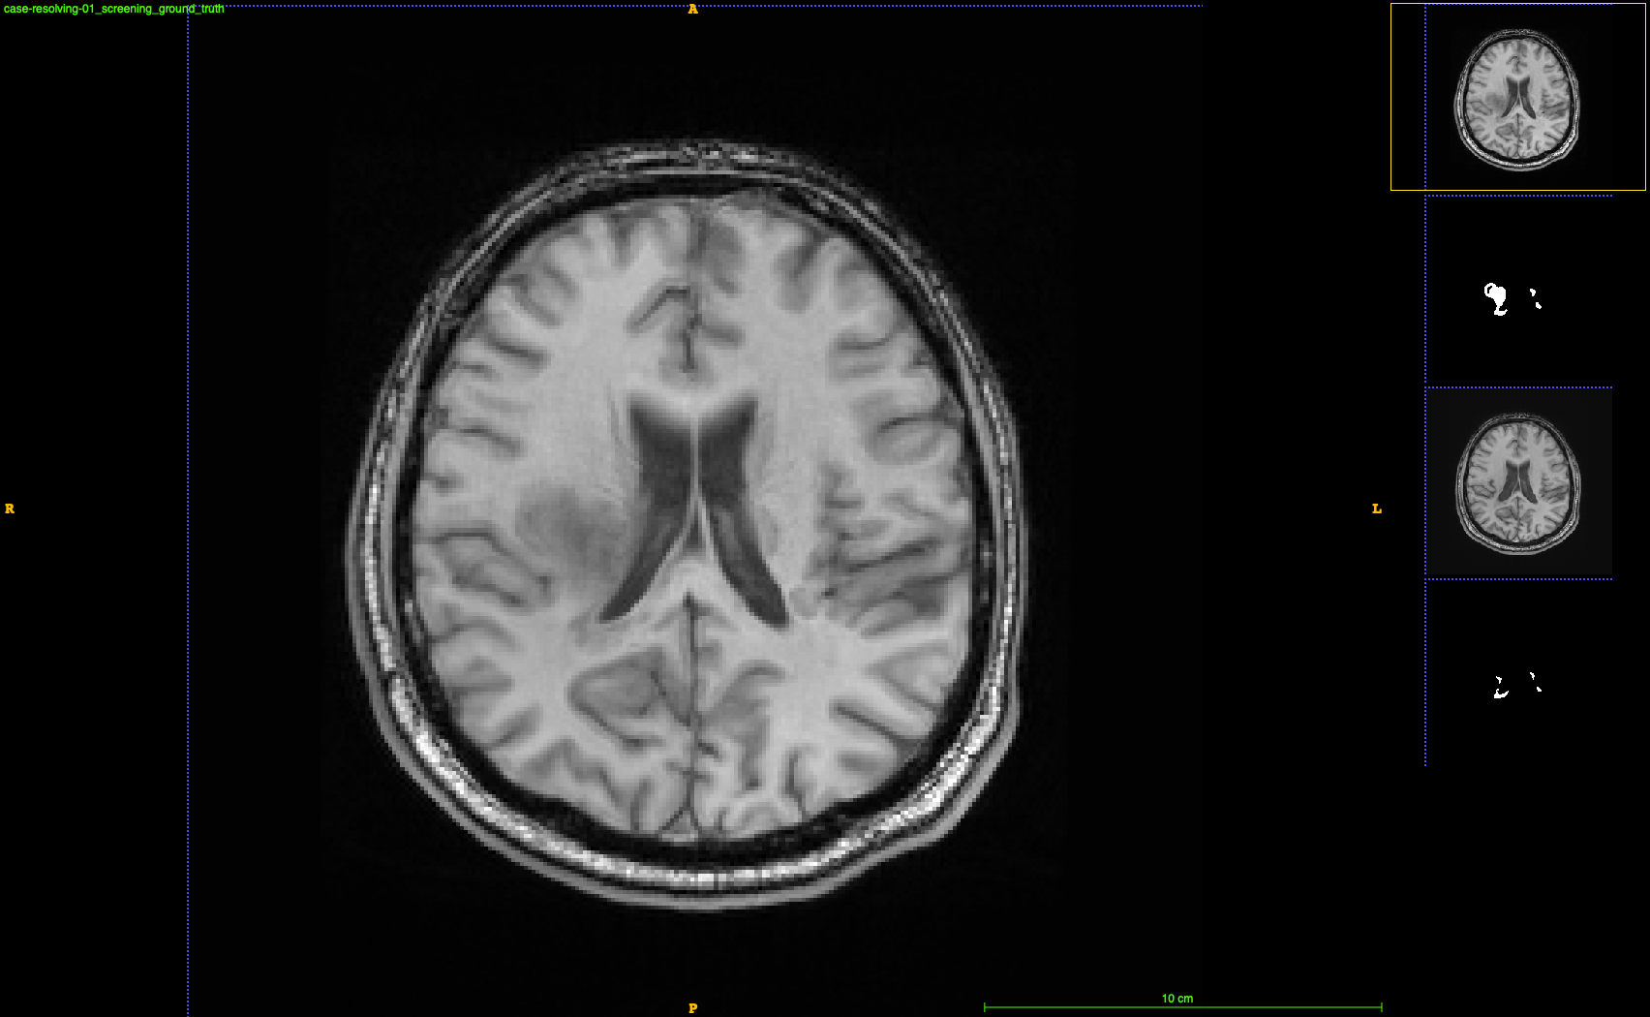
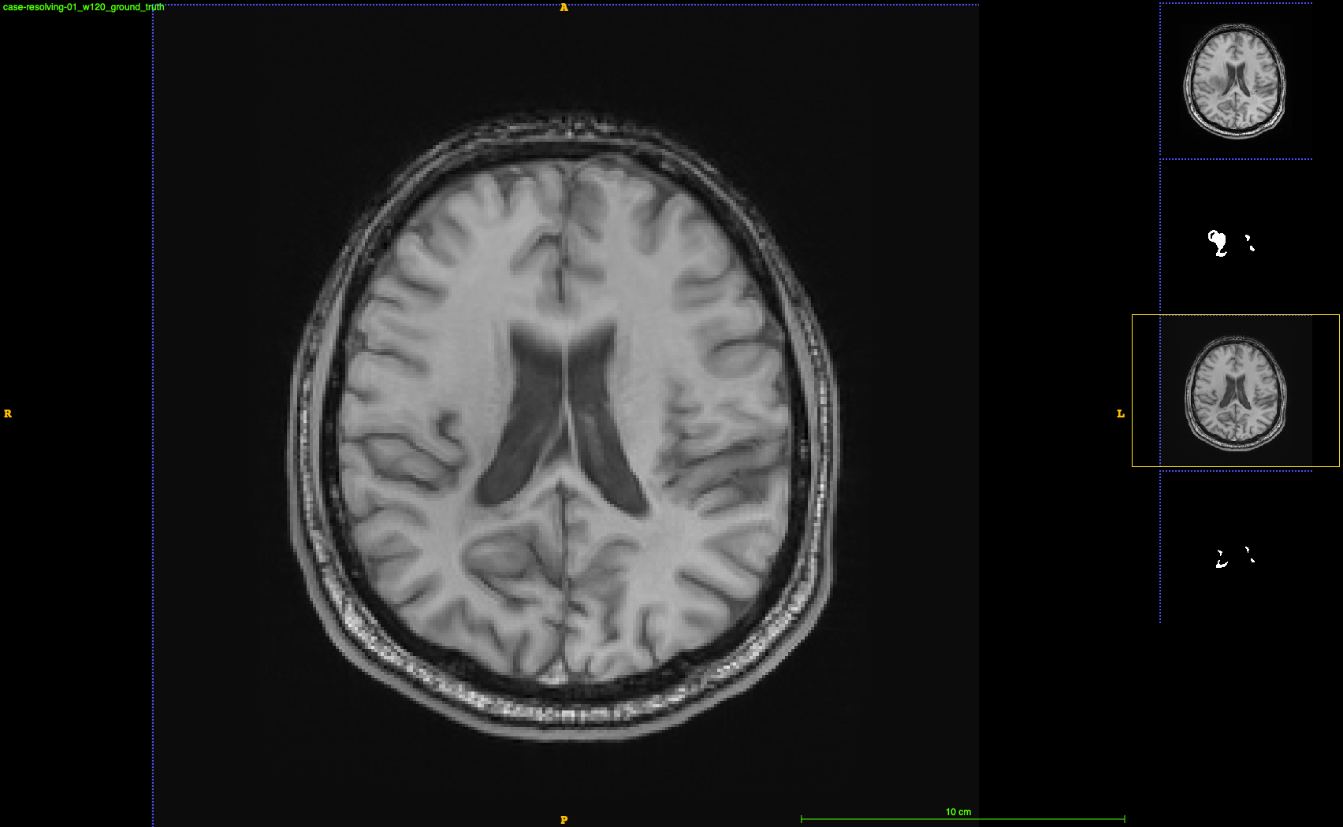
Motivation
screening
Analyze volume changes between patient timepoints.
Jacobian computation distracted by lesions, provides misleading conclusions.
Must remove lesions to accurately estimate volume change; create a GAN model to generate brains with no lesions for Jacobian Integration.
w120

Slide 3
Project Roadmap
Train a 2d model to generate healthy tissue on masked out areas (non-lesion areas) of t1p slices
1
Train a Gan with a discriminator to make sure brain looks realistic
2
Test the trained GAN model on images with real lesions masked out, output as 3d
3
Run a pairwise jacobian integration (PJI) software on the generated images to analyze areas of change (unable to run properly with lesions present)
4
Visually inspect results on unique patient cases
5

Slide 4
Training a PyTorch UNet
Train a 2d model to generate healthy tissue on masked out areas (non-lesion areas) of t1p slices
1
Last summer worked on a 3D Vanilla Unet in Keras Tensorflow for lesion inpainting
This summer: built off of that architecture and translated to PyTorch
Worked with the same DEFINE dataset
Key additions and features:
Added some layers ie MaxPool, Dropout…
Randomly selected 4 different slices (for data augmentation) for each patient (Patient A) and randomly pulled other patient’s (Patient B) lesion mask at their middle slice and masked them onto healthy tissue on Patient A, mimicking lesions.
UNet only outputs the area with lesions inpainted, loss was calculated on that area vs true healthy tissue under the simulated lesion mask.

Slide 5
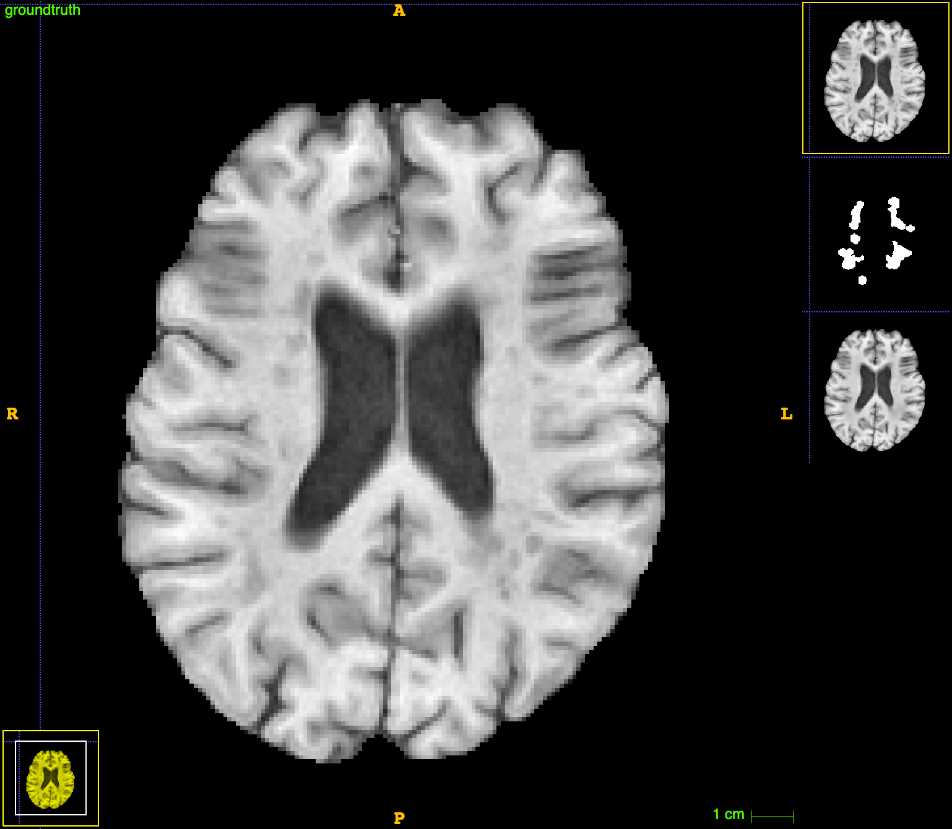
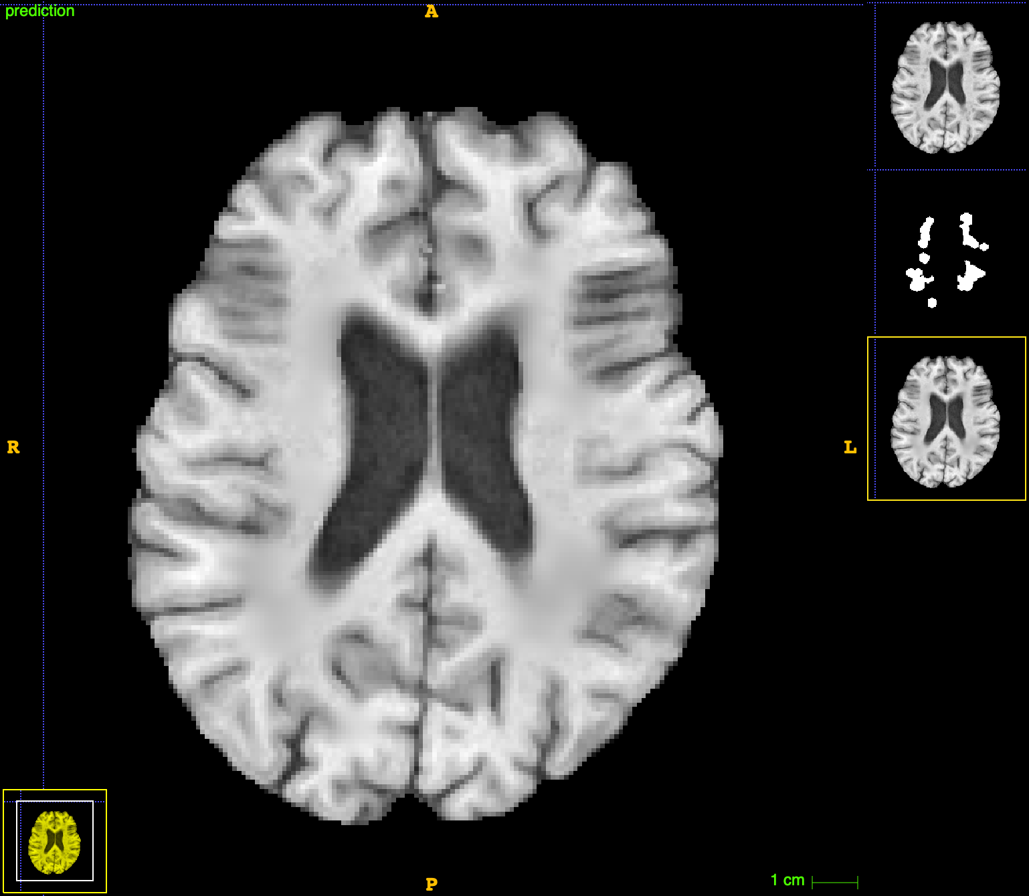
UNet results
Train a 2d model to generate healthy tissue on masked out areas (non-lesion areas) of t1p slices
1
After the model learned to inpaint healthy tissue, real lesions were masked out on test images and fed into the model.
Brain with lesions
Lesions inpainted out

Slide 6
Training a GAN
Train a Gan with a discriminator to make sure brain looks realistic
1
The discriminator: a simple stacked convolutional network
Key additions and features:
Added BatchNorm and Bottleneck layers to generator (UNet)
Created a balanced loss containing pixelwise loss and adversarial (discriminator) loss
For the pixelwise loss, implemented compound loss that uses 70% of the loss of the inpainted area and 30% of the loss of the full lesion-free image (to prevent overfitting/smoothness/blurriness and keep image unique)
Used Structural Similarity Index Metric (SSIM) as pixelwise loss
2

Slide 7
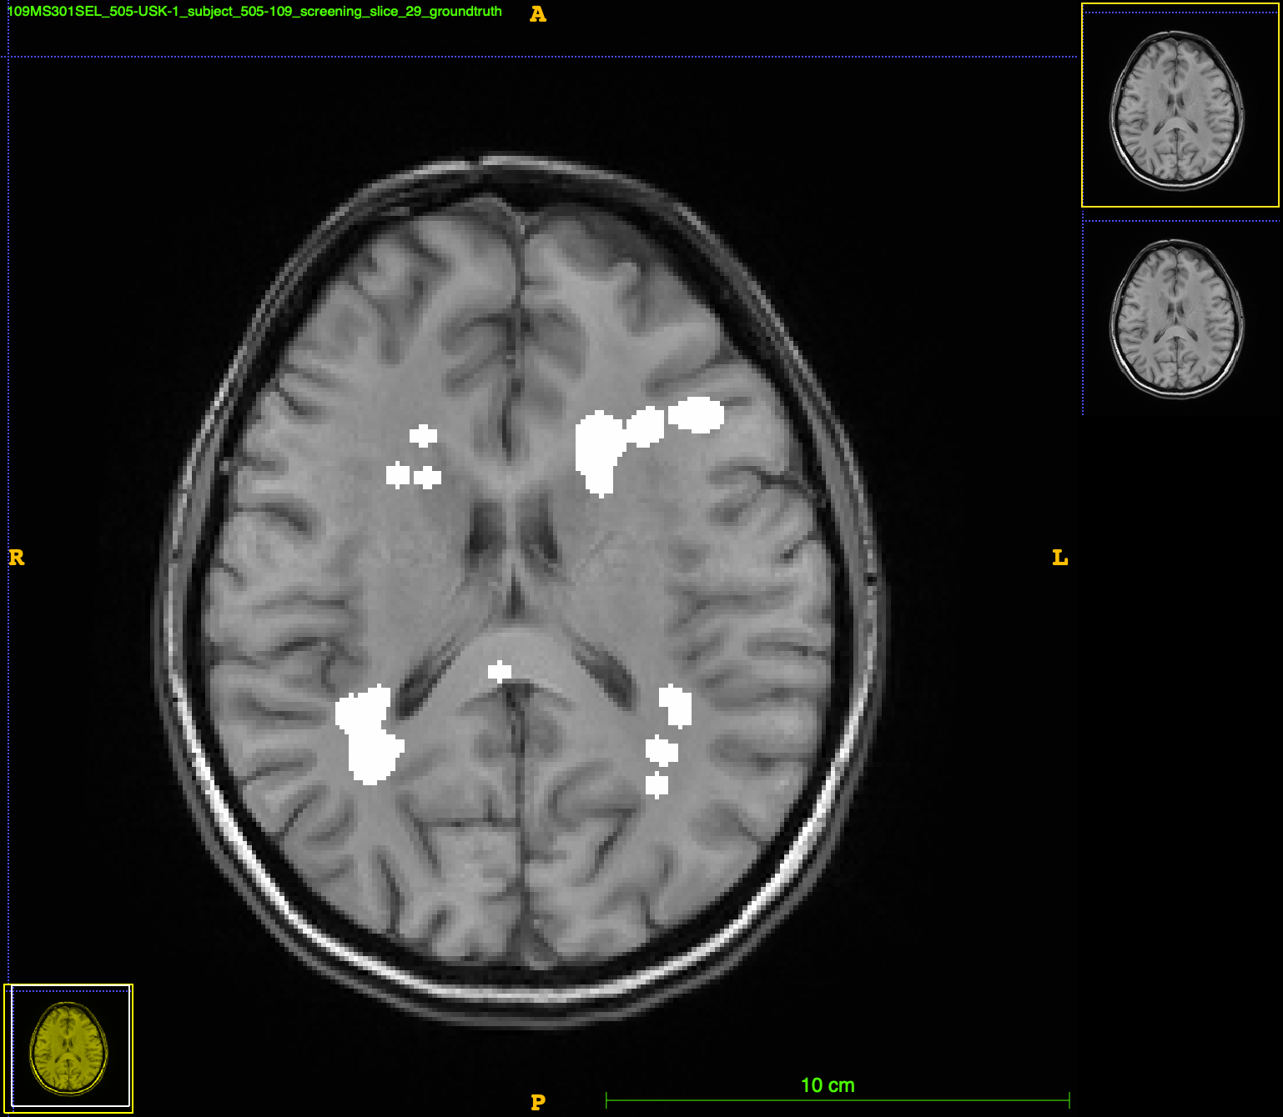
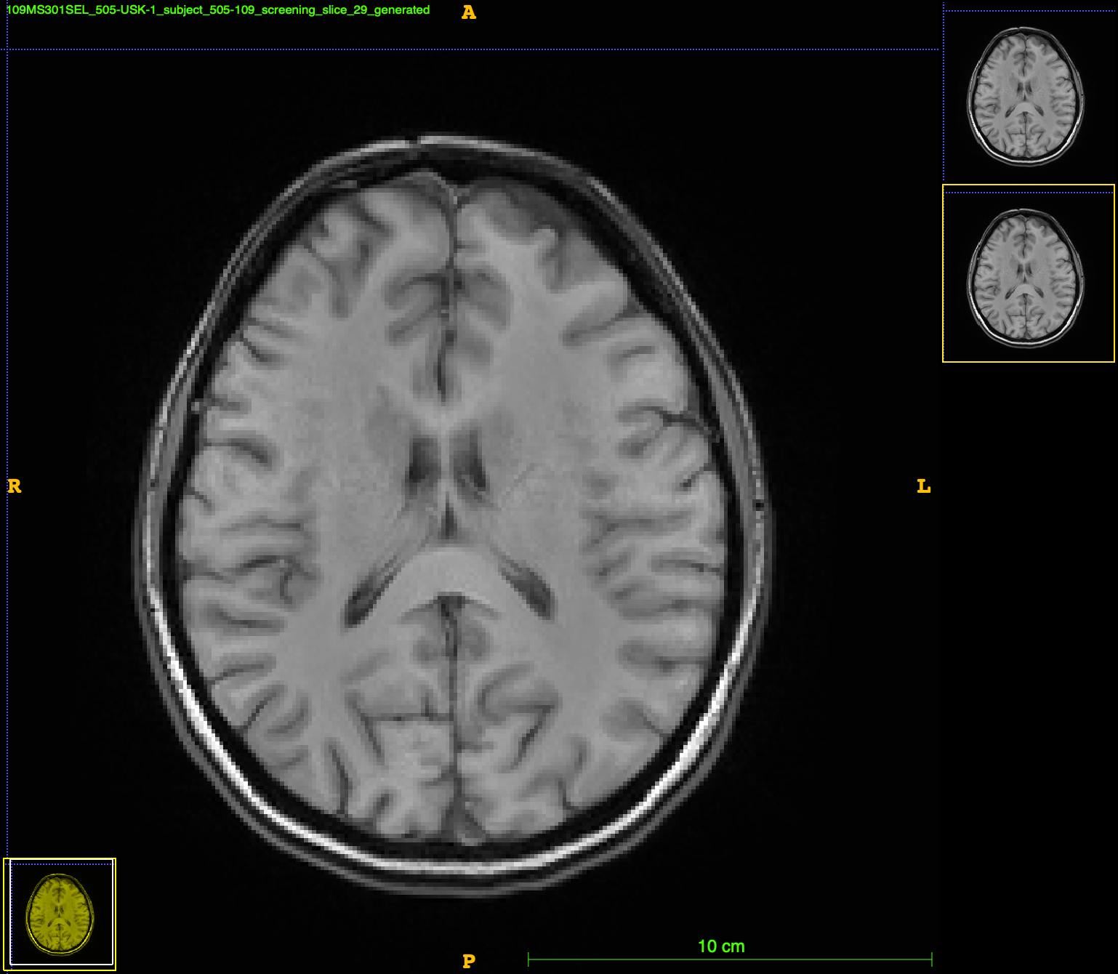
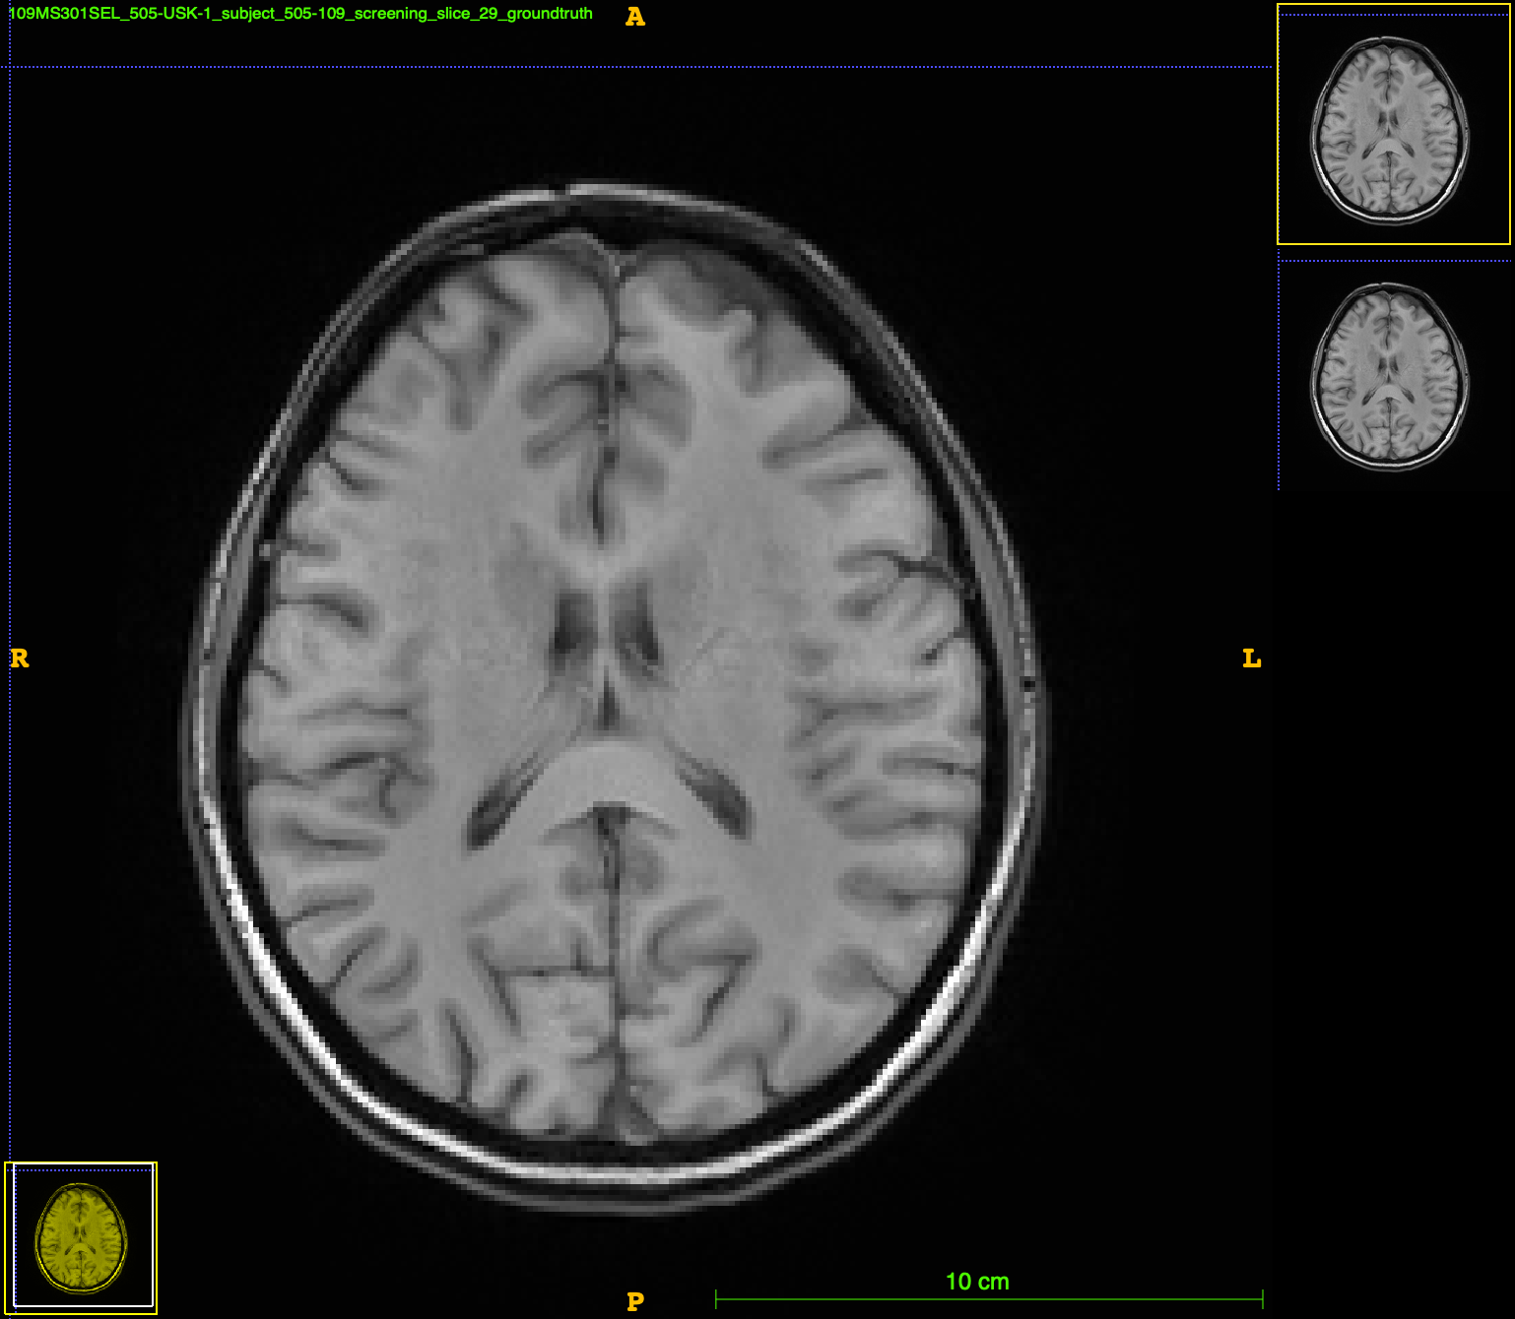
Full Model Training Overview
Brain Slice with Randomly Masked Healthy Tissue
Brain Slice with Inpainted Patches
Generator
Optimizes generator
Brain Slice
Fake
Discriminator
Real

Slide 8
Inference
Test the trained GAN model on images with real lesions masked out, output as 3d
1
Fed test image slices with lesions masked out into trained generator.
Implemented Fréchet Inception Distance (FID) as quantitative measure of results.
Created multiple models with different hyperparameters ie L1loss, mask dilation iterations, mse loss, learning rate…
Saved inpainted results for patients with significant change in lesion weight over several timepoints (+-20%).
To 3D: analyze a patient slice by slice, if there are lesions, replace slice with generated slice, if not, leave slice as is.
3

Slide 9
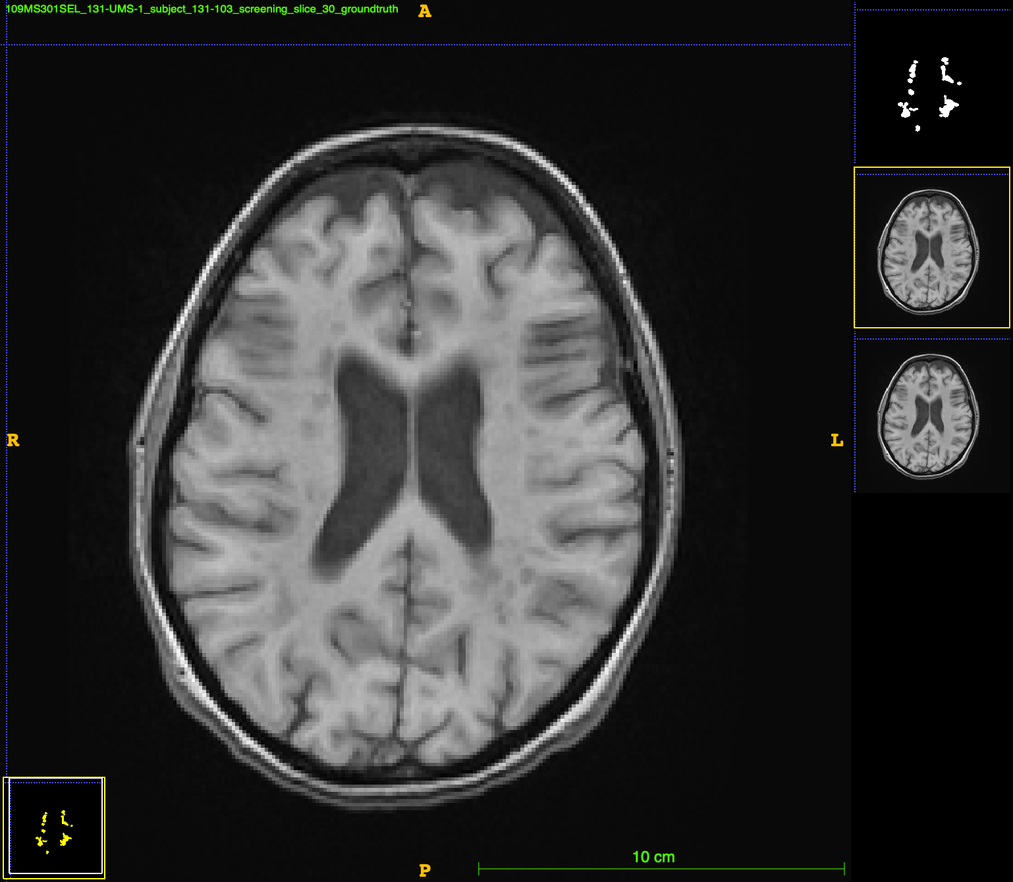
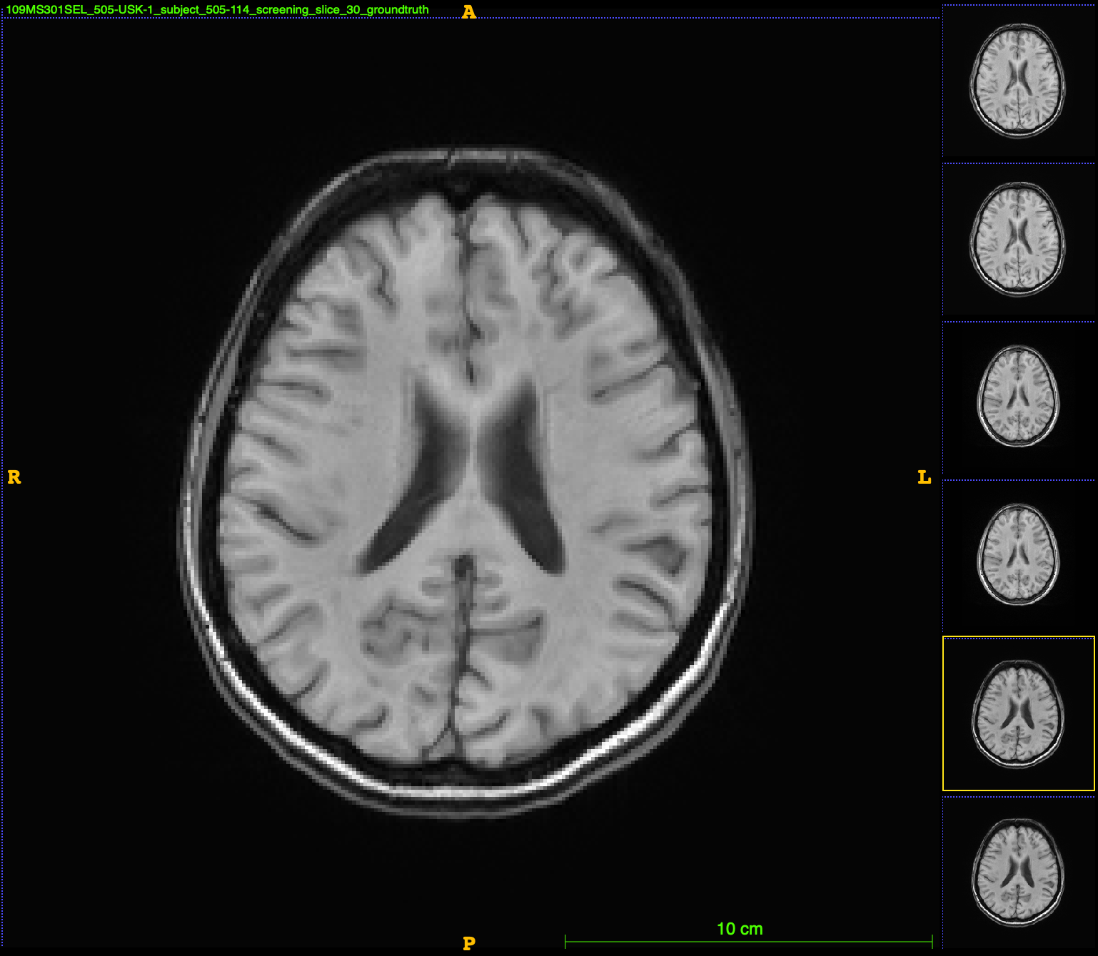
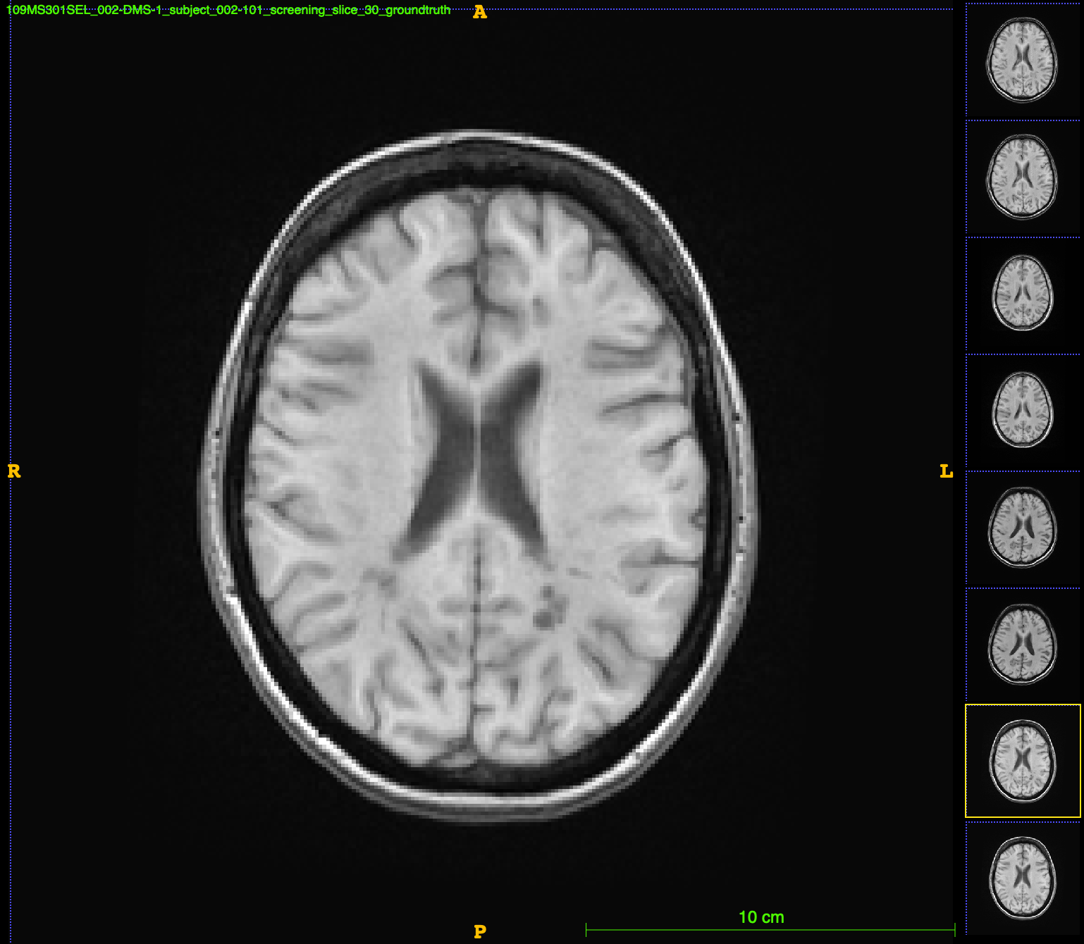
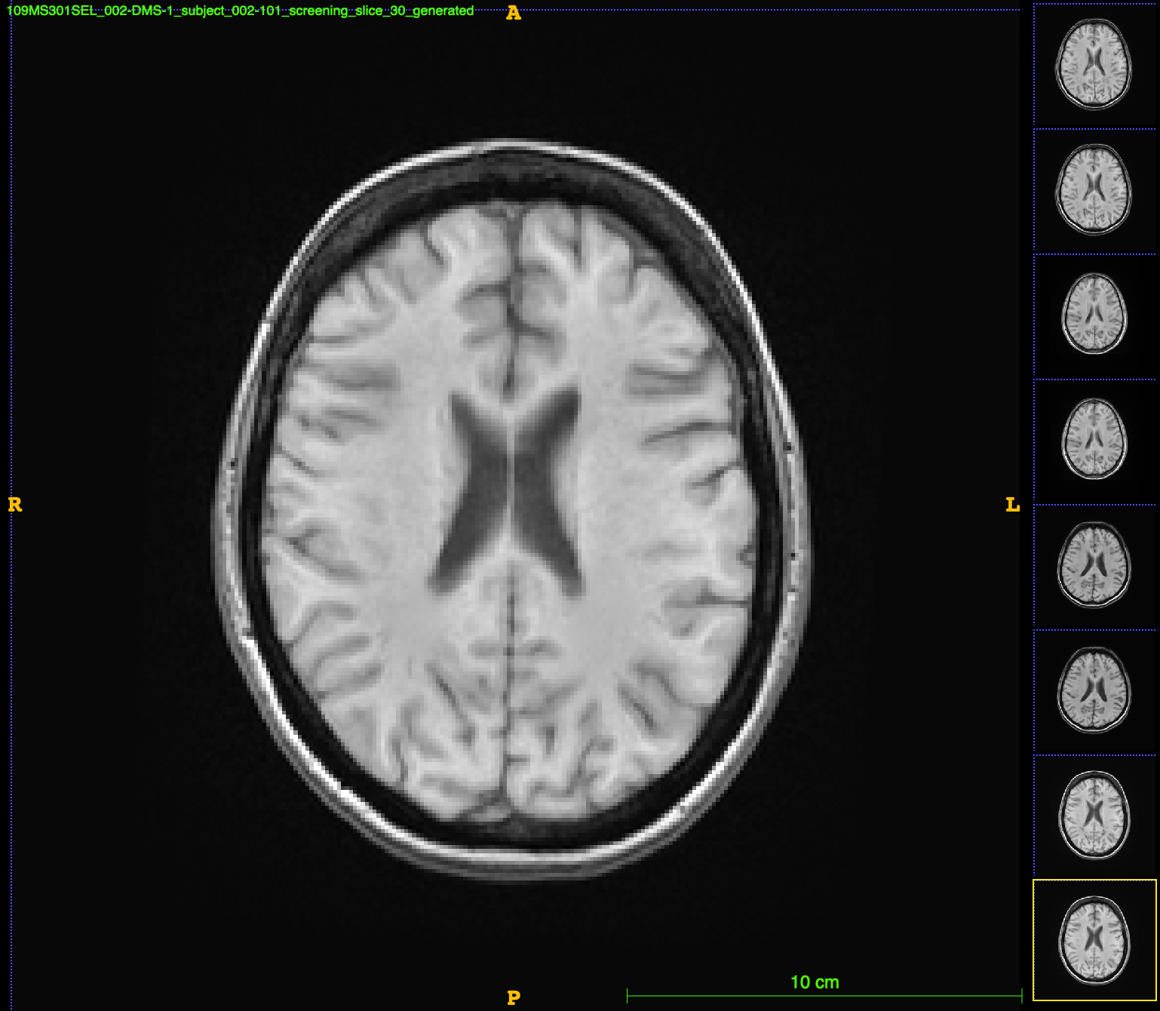
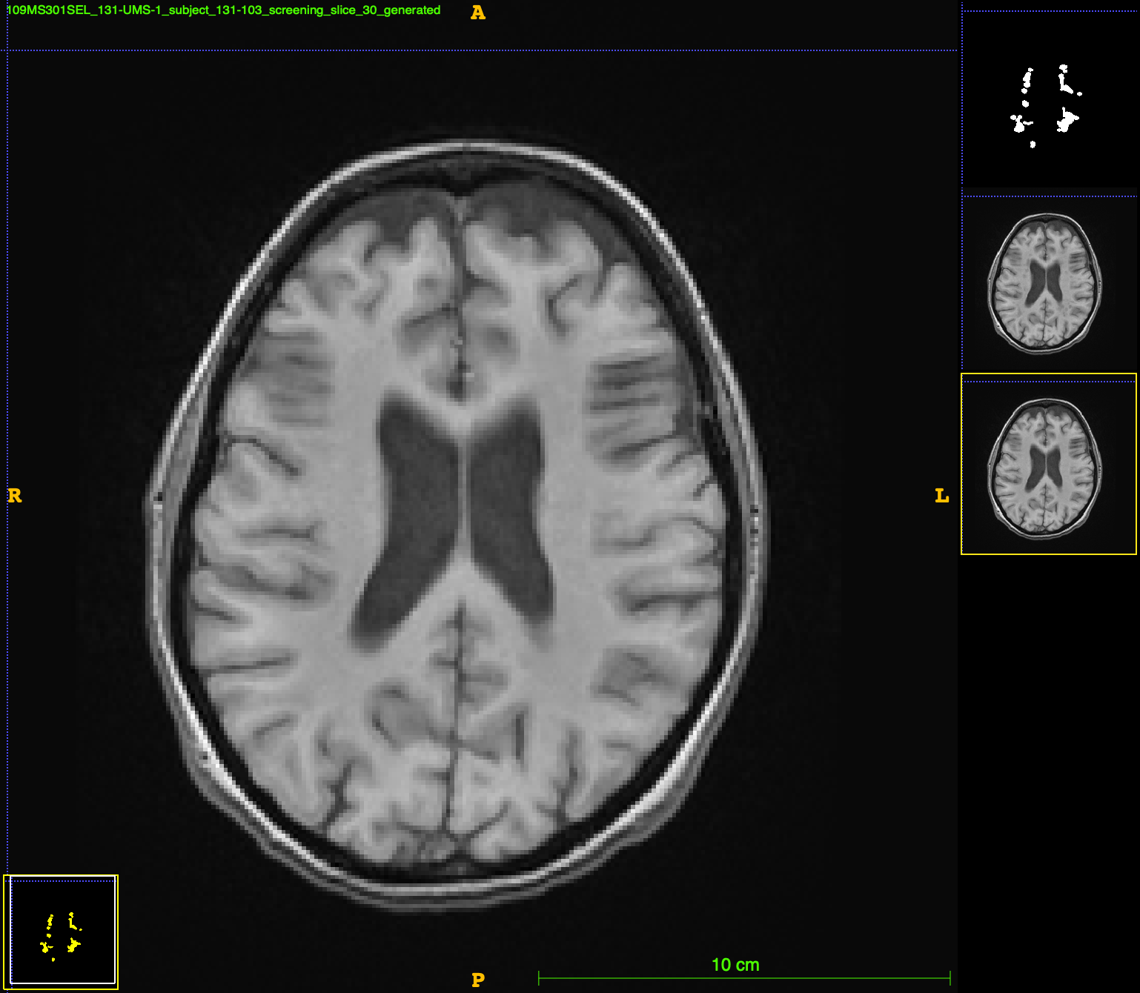
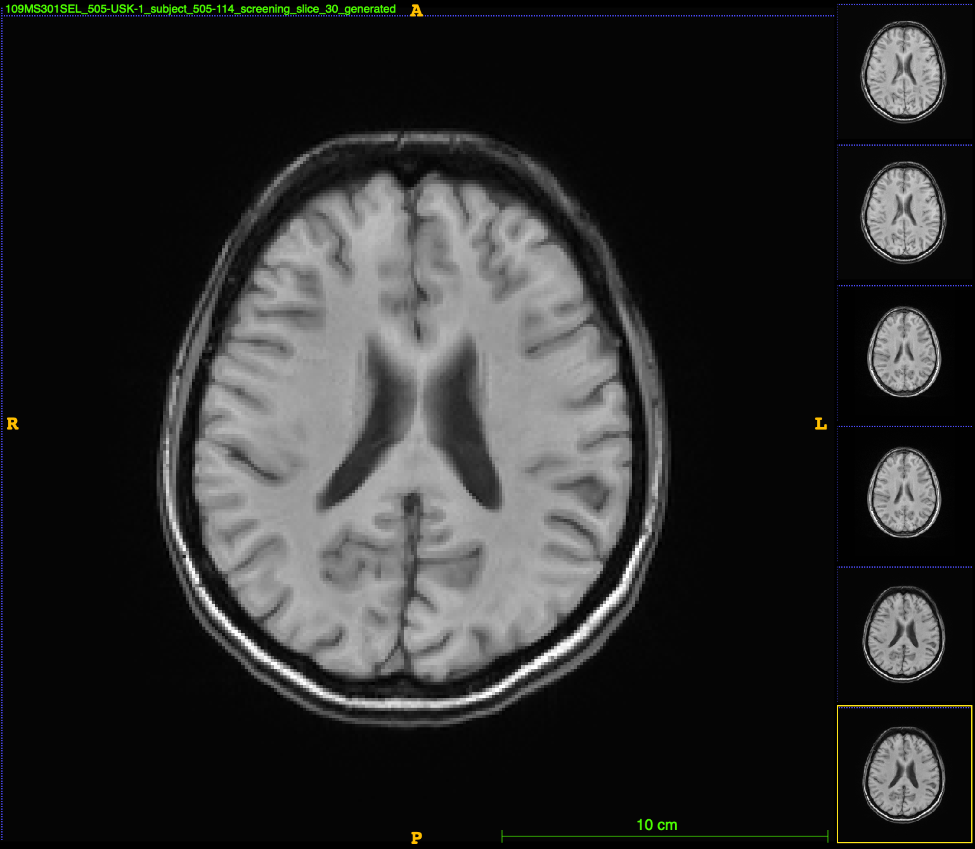
GAN Results
Slice with Lesions
Slice without Lesions

Slide 10
Jacobian Integration
Run a pairwise jacobian integration (PJI) software on the generated images to analyze areas of change (unable to run properly with lesions present)
1
Visually inspect results on unique patient cases
2
Creates volume change map between 2 timepoints
In some cases with resolving or new lesions, jacobian highly skews this change, impossible to find volume change
Here are is a case with a rapidly resolving lesion:
4
5

Slide 11
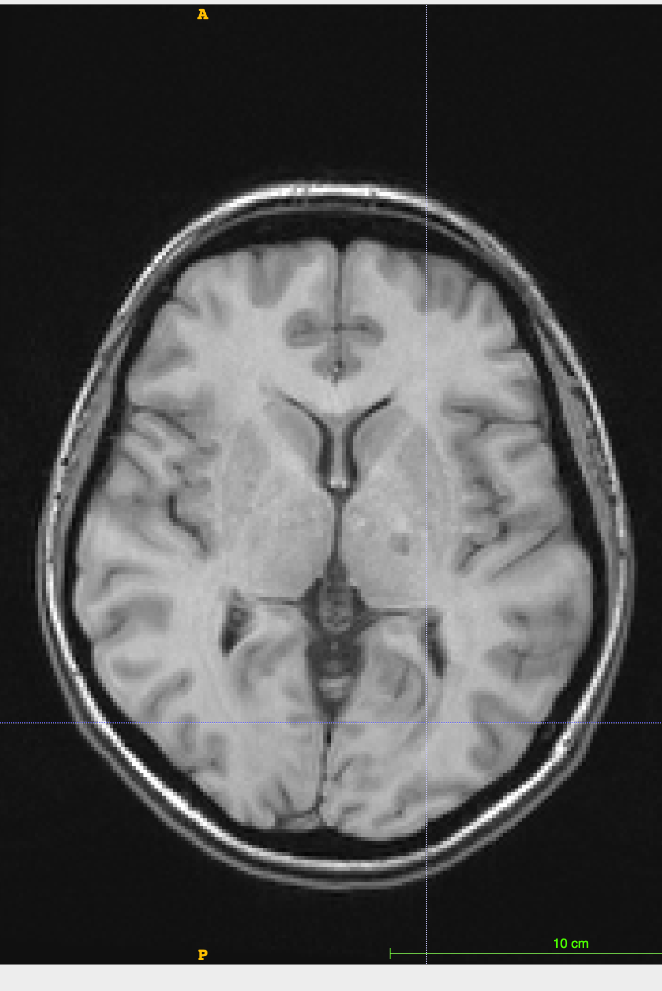
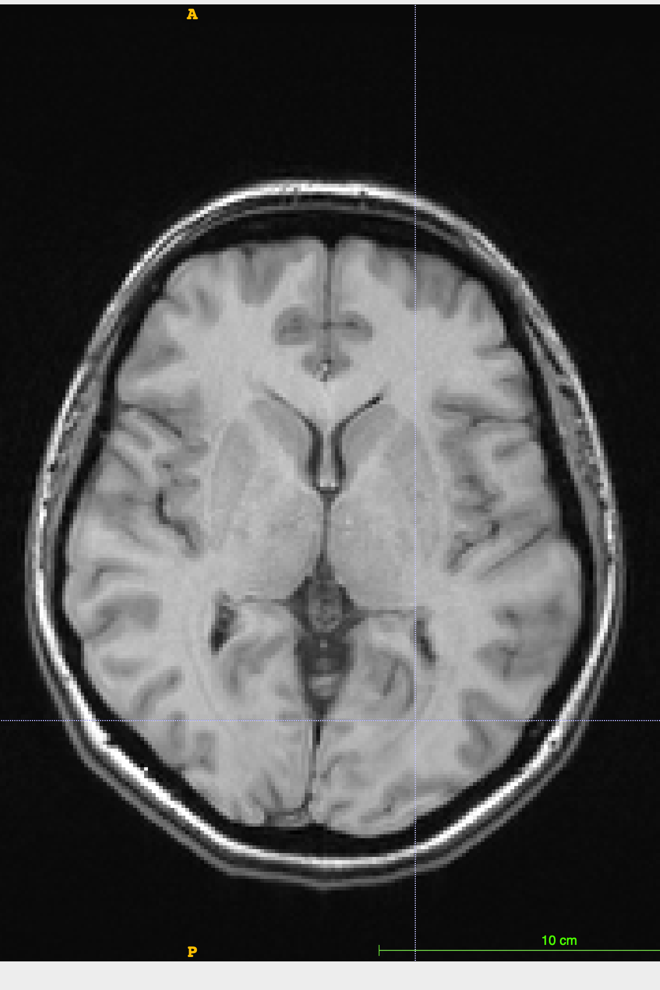
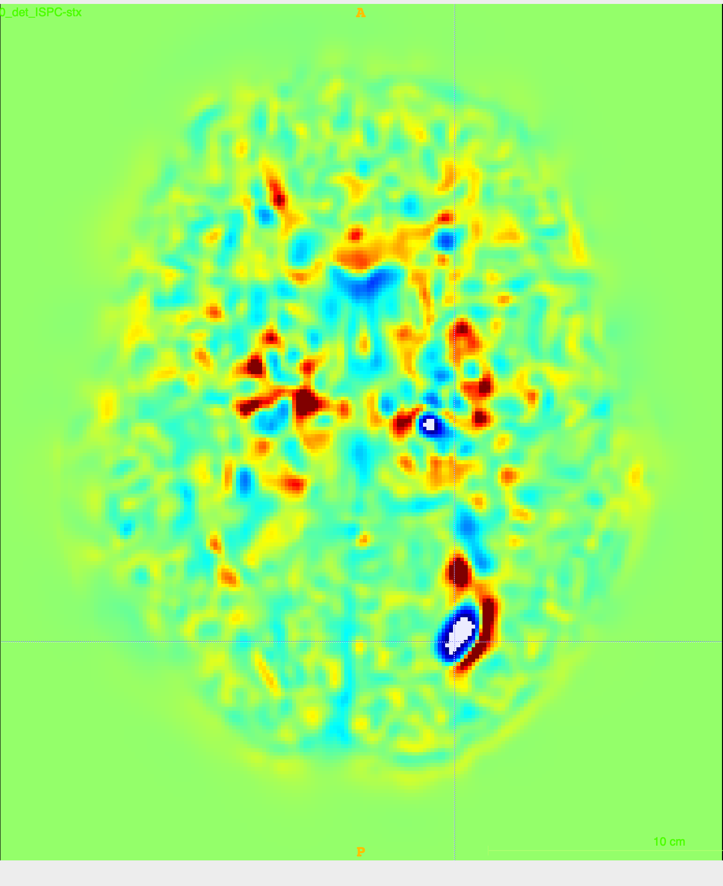
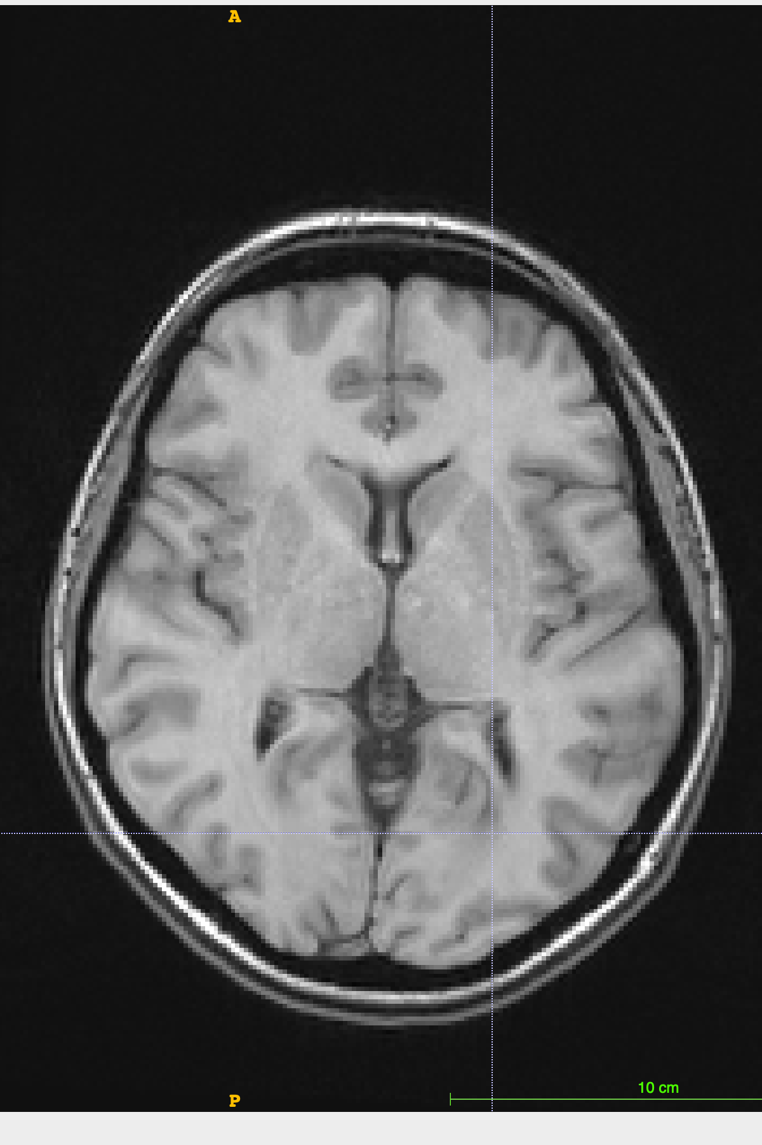
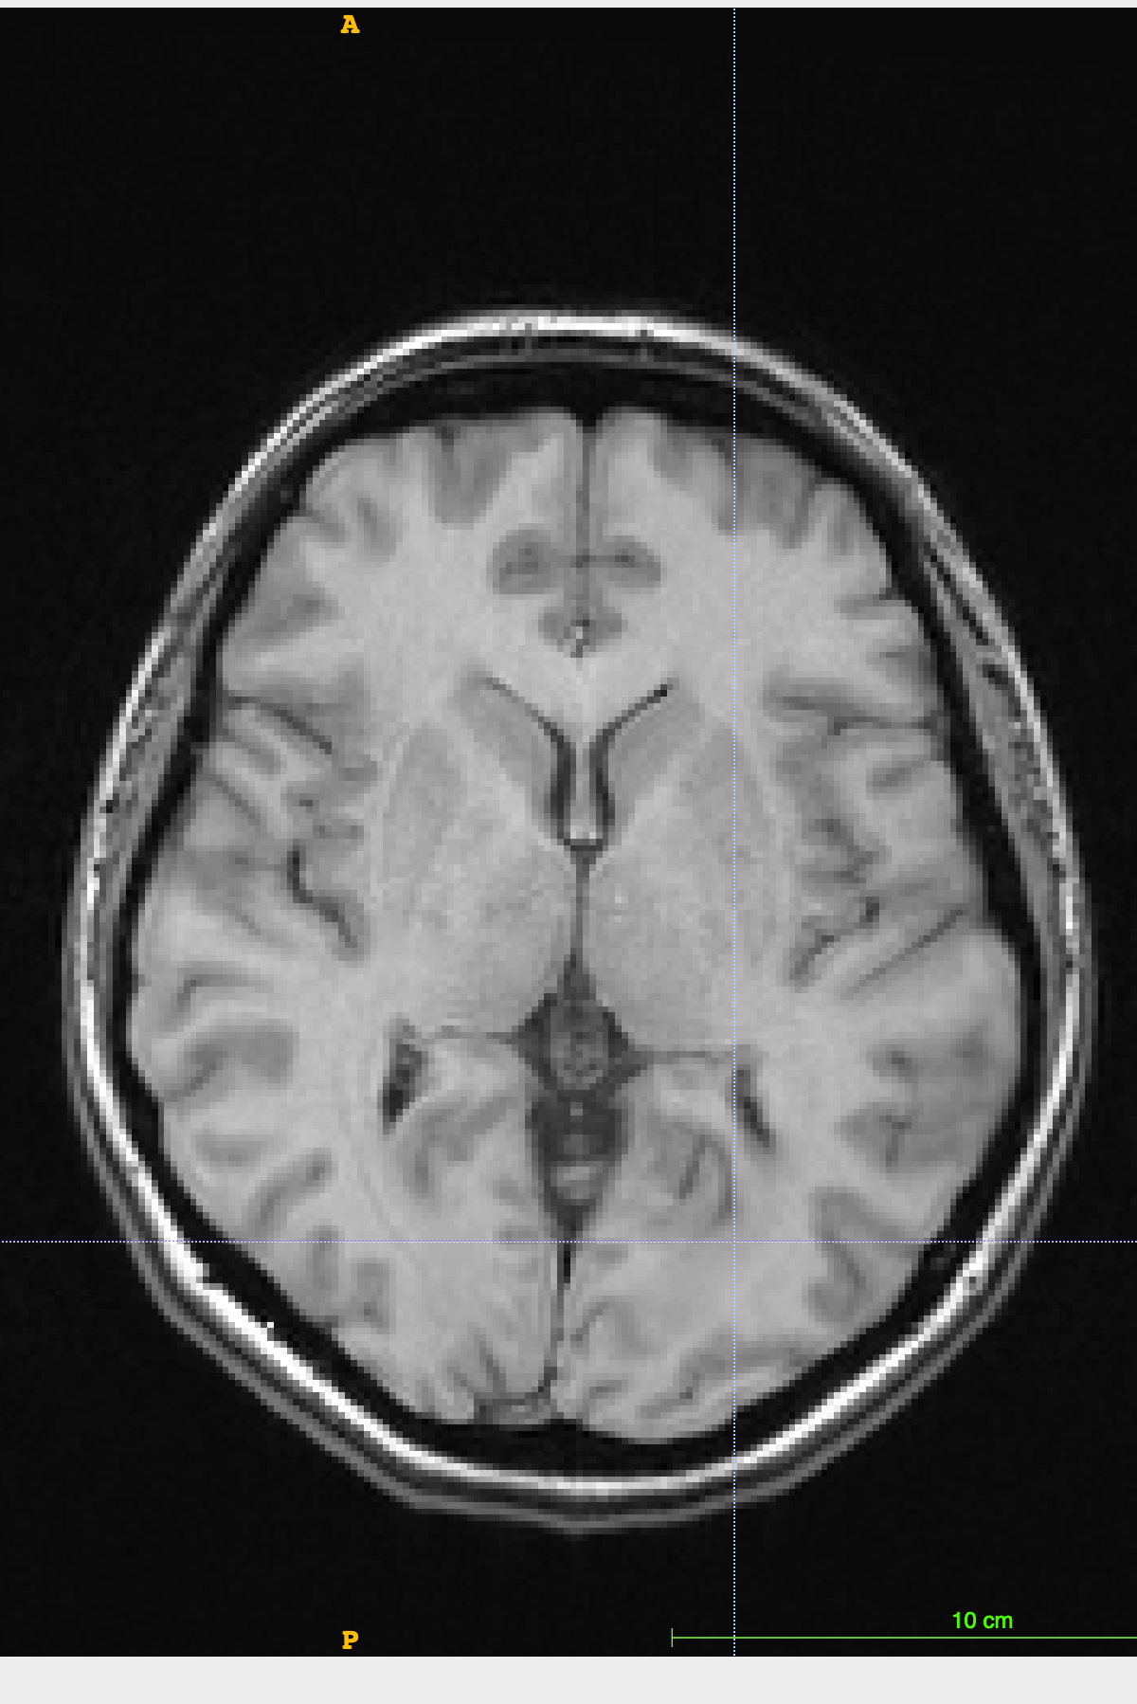
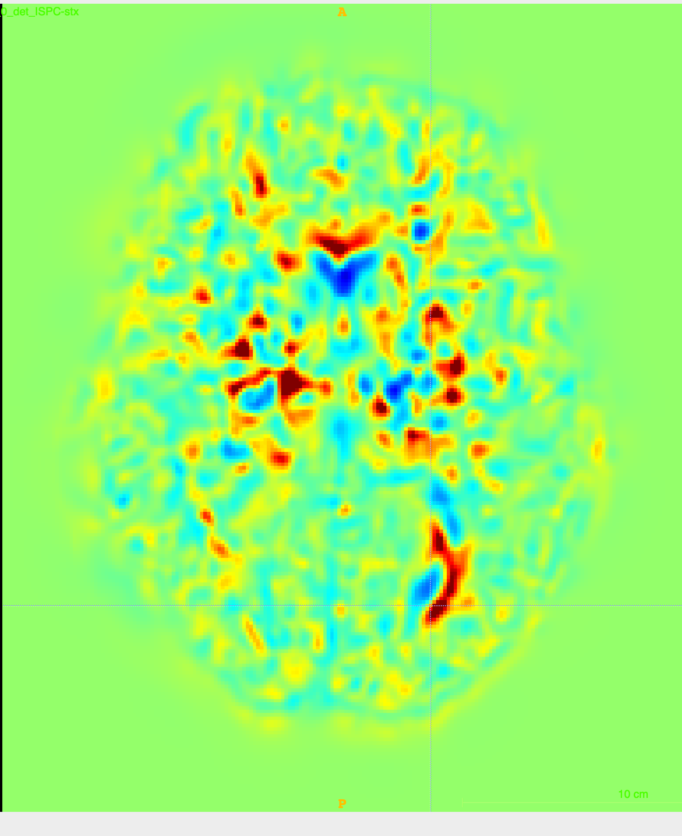
Jacobian map for img with lesions
Img at timepoint 1
Img at timepoint 2
Jacobian map for img with inpainted lesions
Inpainted img at timepoint 1
Inpainted img at timepoint 2

Slide 12
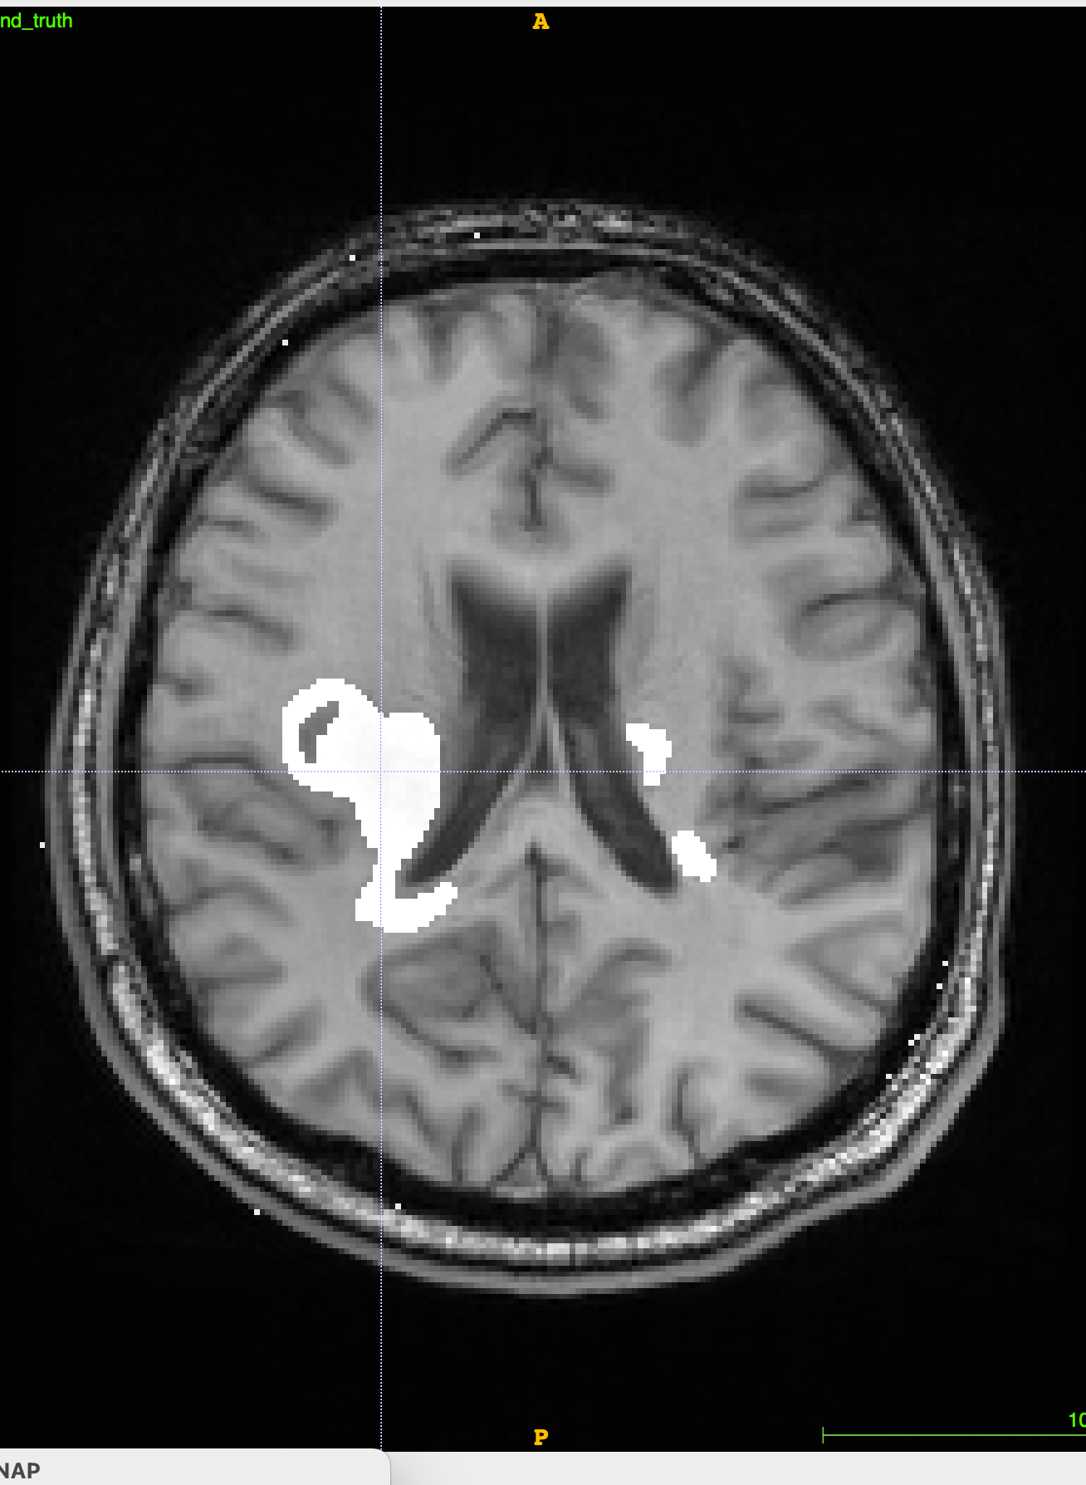
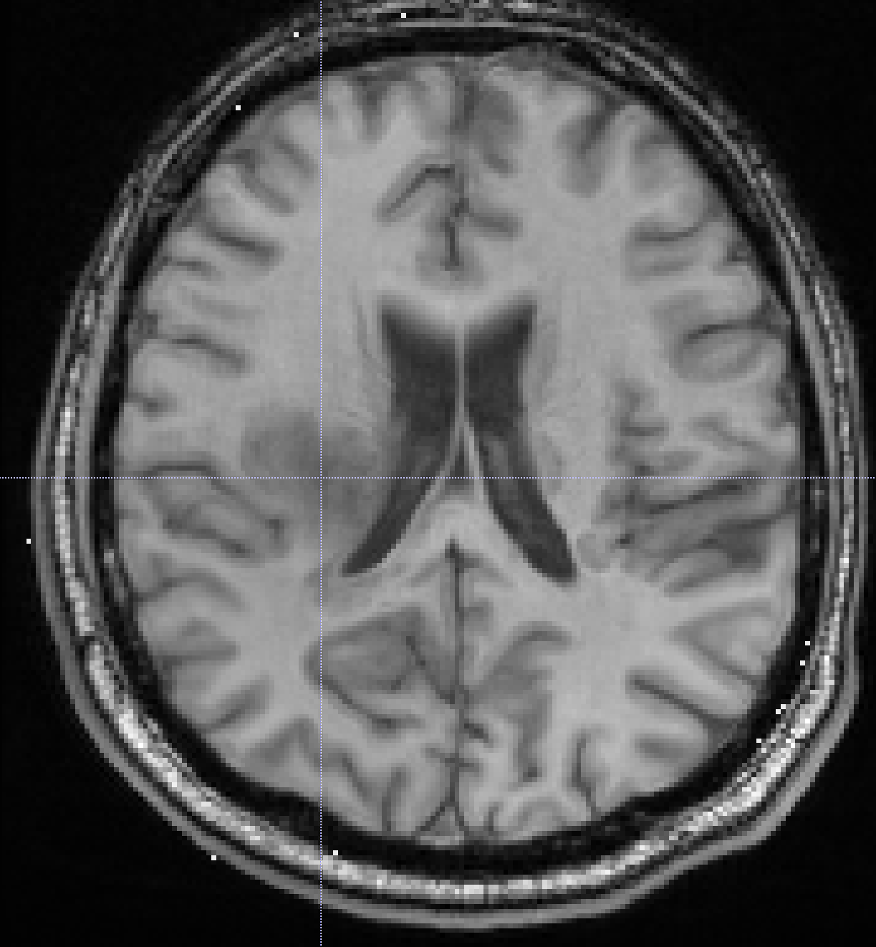
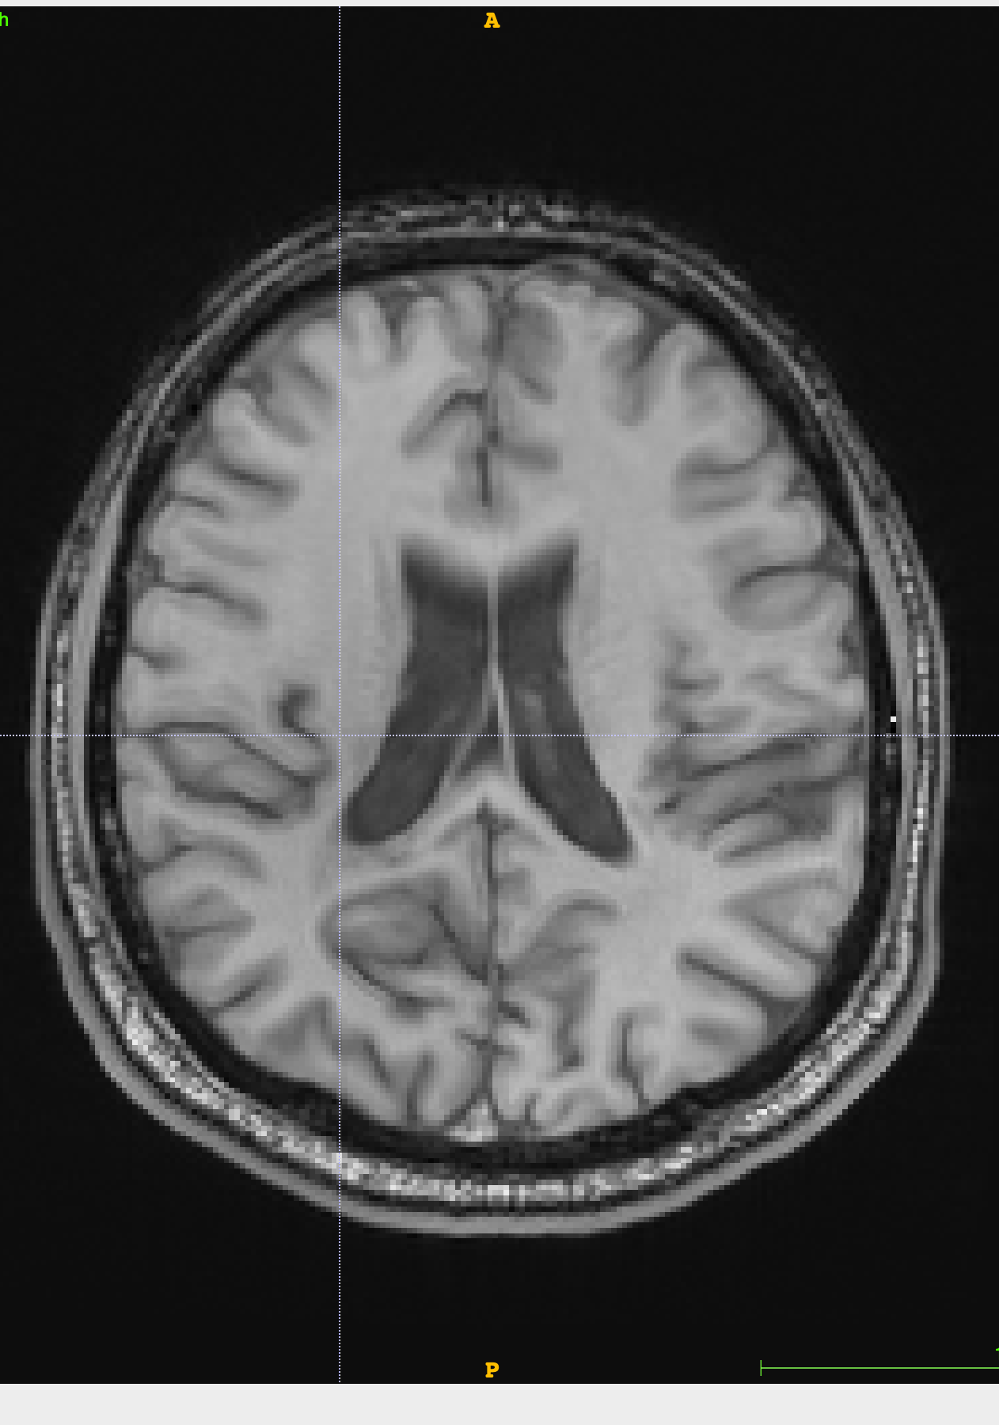
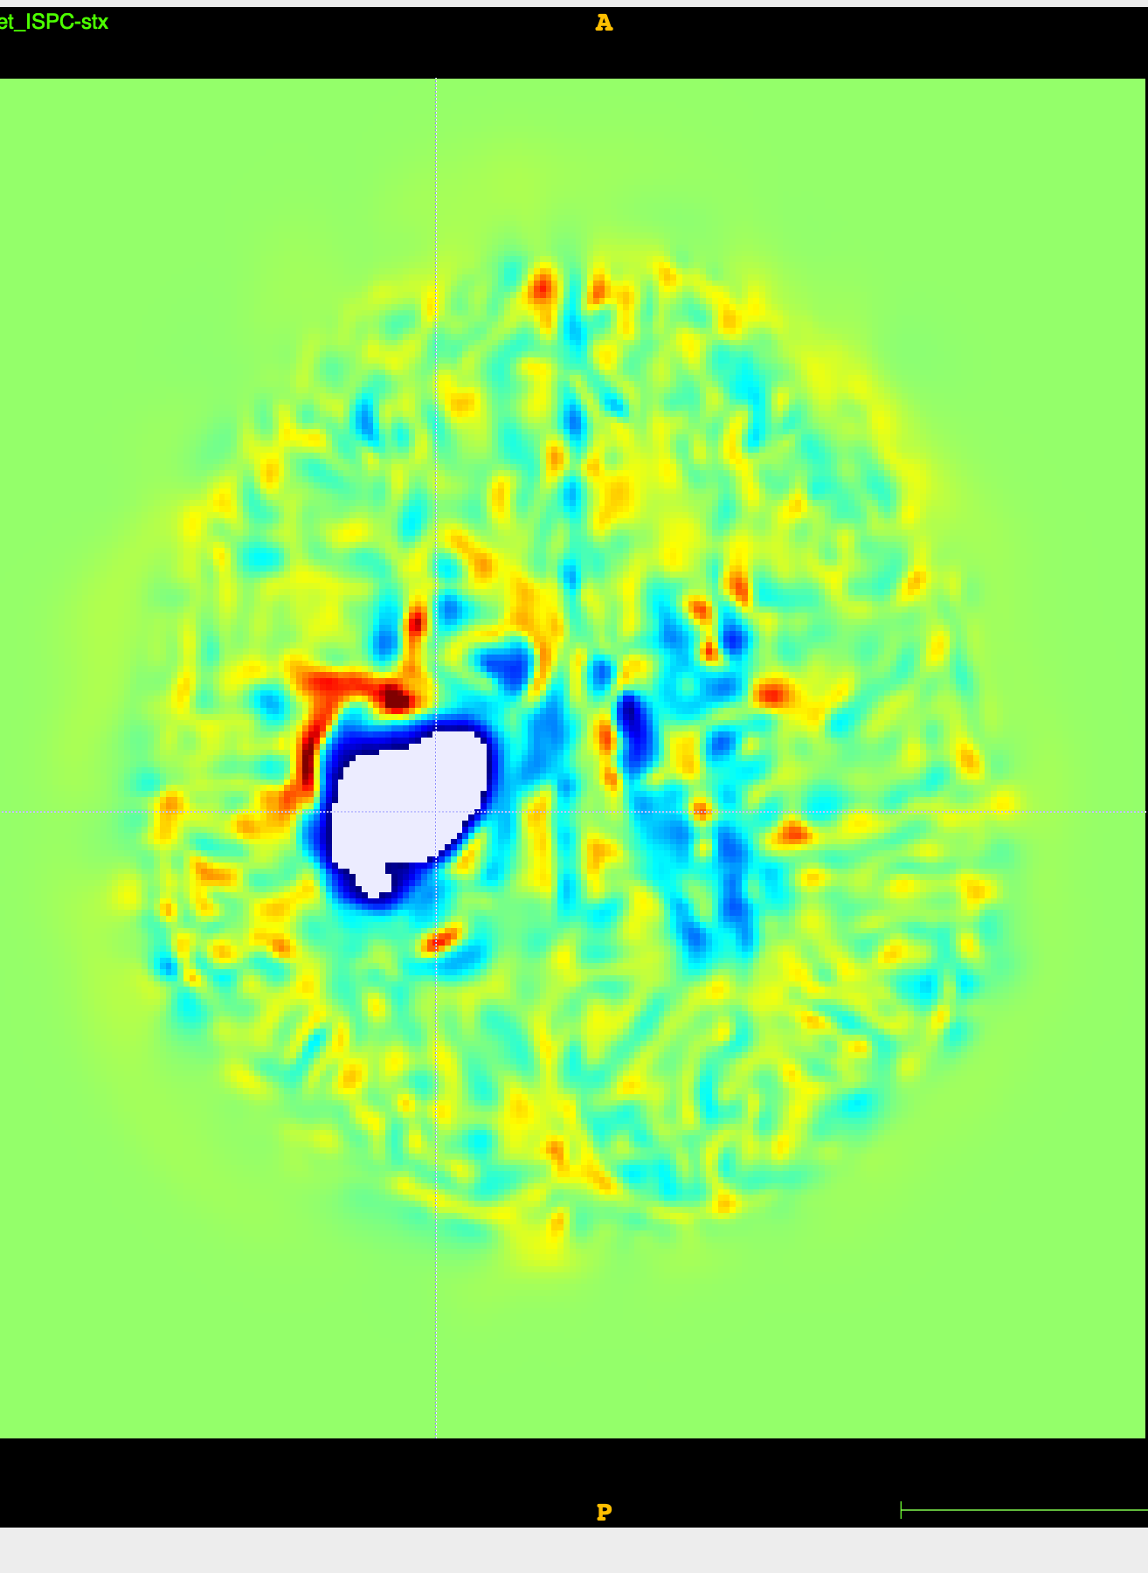
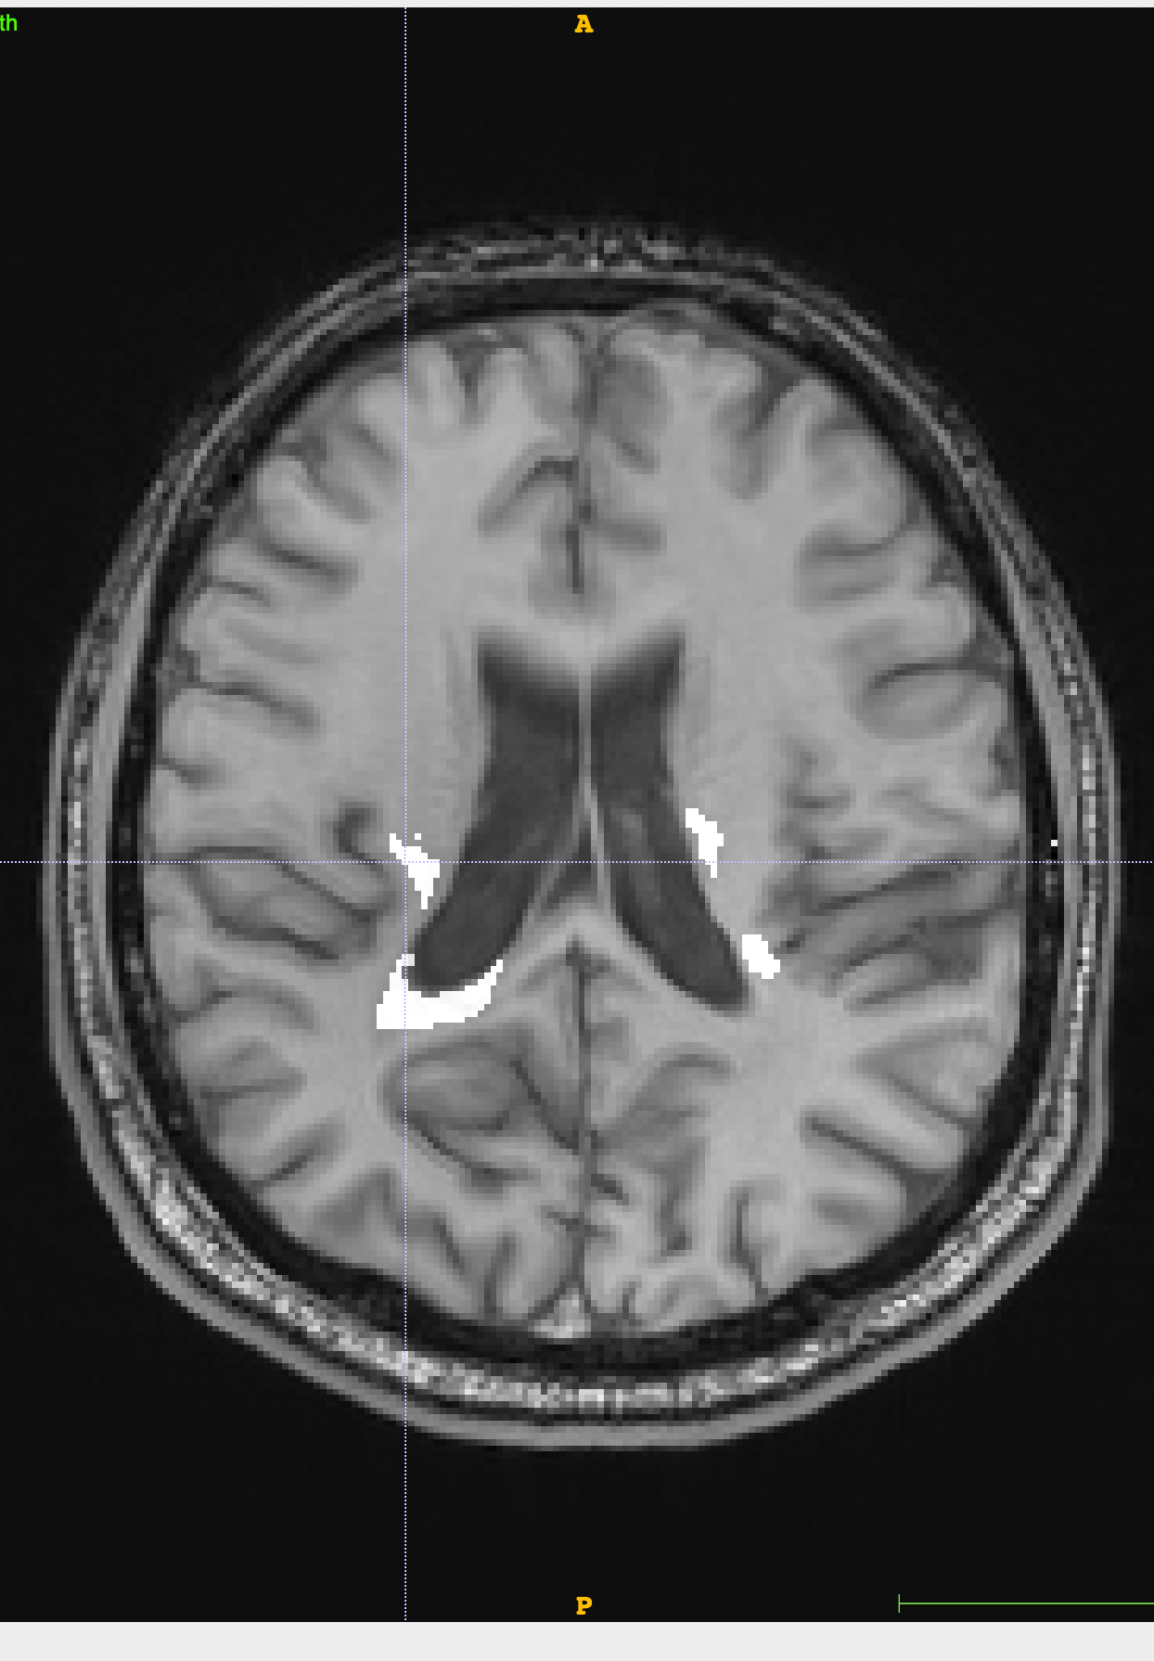
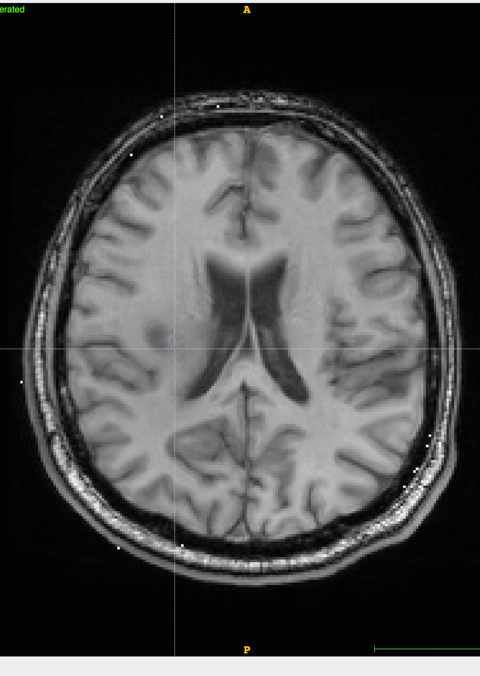
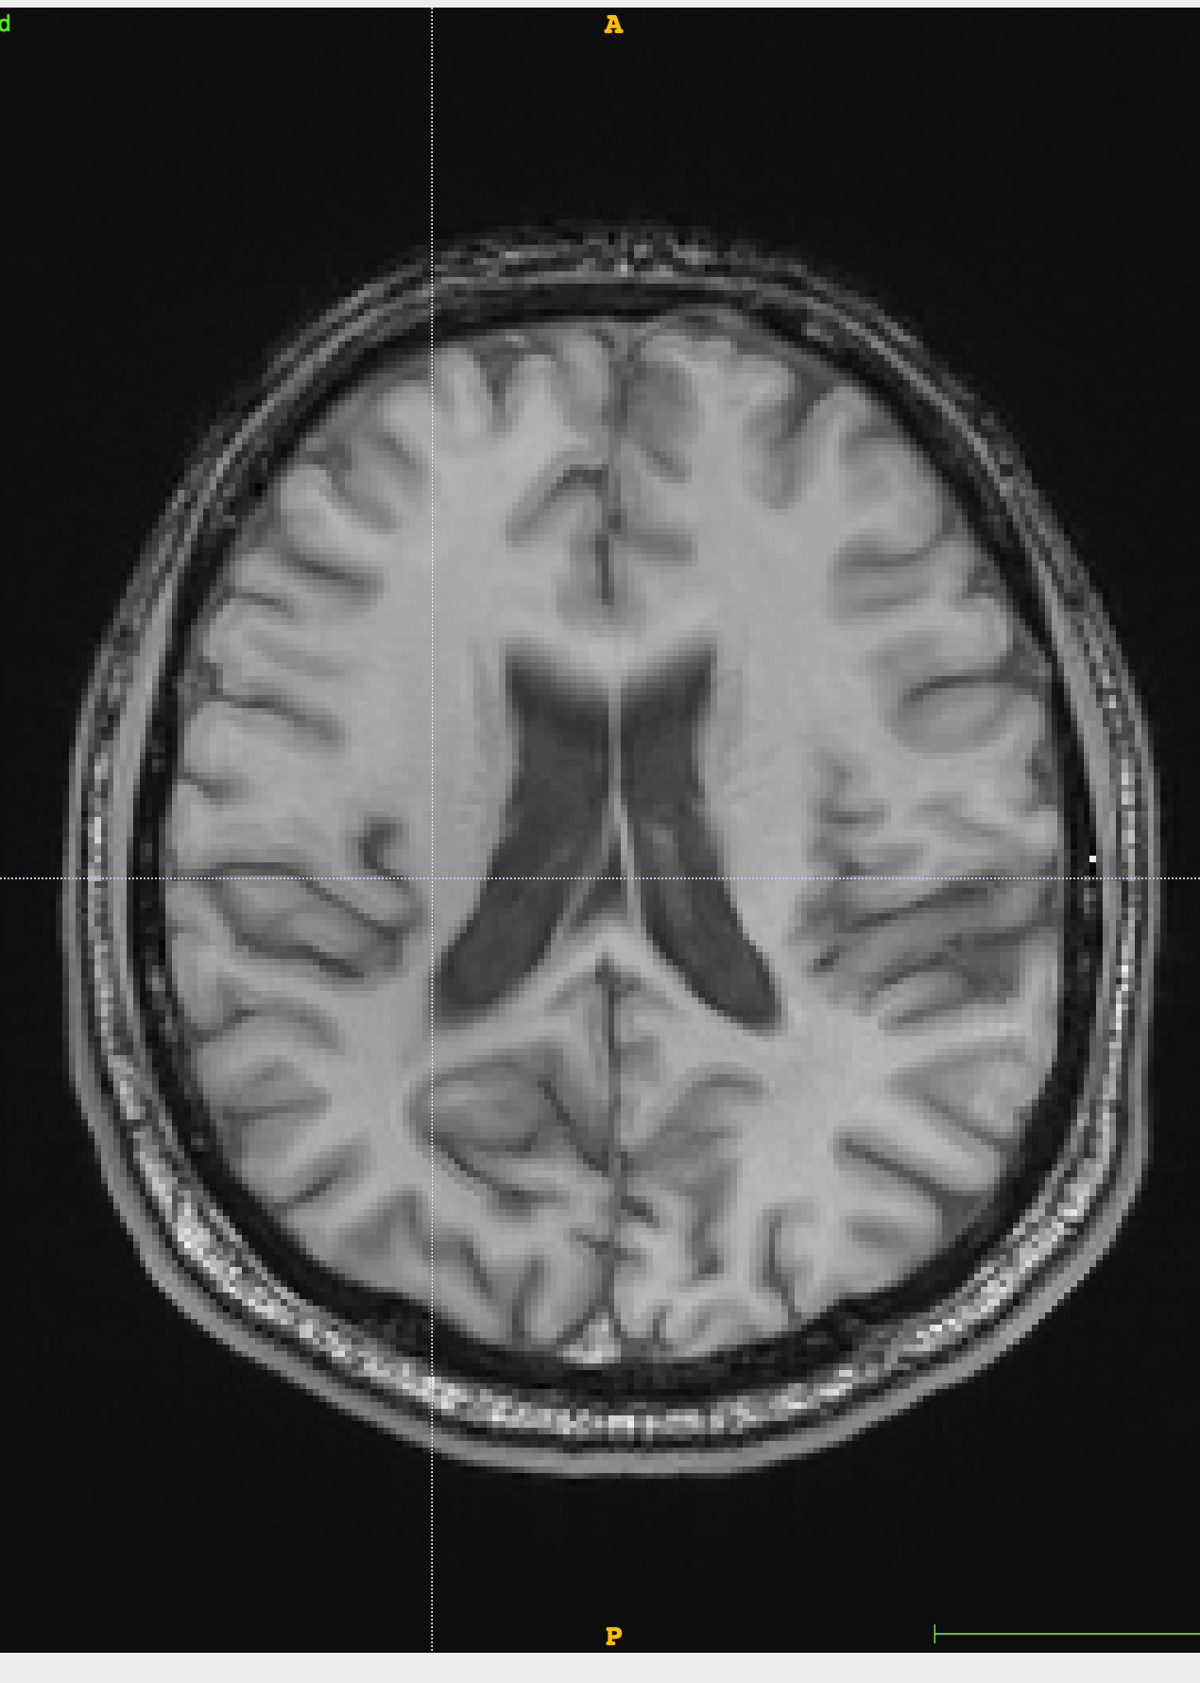
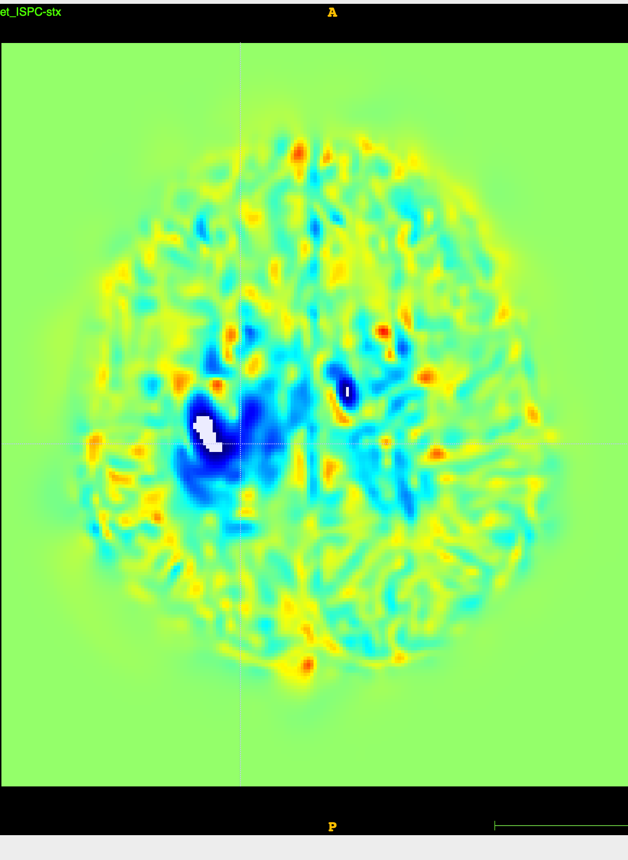
Brain slice masked out lesions at timepoint 1
Brain slice with lesions at timepoint 1
Brain slice with lesions at timepoint 2
Jacobian map for brain with lesions
Brain slice lesions inpainted at timepoint 1
Brain slice lesions inpainted at timepoint 2
Brain slice with masked out lesions at timepoint 2
Jacobian map for brain with lesions inpainted

Slide 13
Future Project Possibilities and Improvements
Create a true 3D GAN, where areas are fed in through patches.
Larger and more robust dataset.
Apply more unique and larger lesions masks during training.
Implement a quantitative metric to quantify Jacobian results.
More sophisticated Discriminator architecture
More hyperparameter tuning (different loss functions)

Slide 14
Thank you!
z

